Slide 1
Advanced Information Retrieval
UNIT-6

Slide 2
Introduction
Basic XML concept
XML stands for extensible markup language.
The XML standard was created by W3C to provide an easy to use and standardized way to store self describing data.
XML is not a replacement for HTM and traditional databases.
XML provides the ability to structure, optionally validate and transform data. allowing it to be used across various applications in a platform independent manner.
The term "Extensible" refers to the capability of being extended while the phase "Markup Language" refers to the set of conventions used for encoding textual information.

Slide 3
XML Document
XML documents are text based
The basic object in XML is the XML document.
XML documents, including XHTML ones, must be well-formed.
There are two main structuring concepts that are used to construct an XML document: Elements and Attributes.
Attributes in XML provide additional information that describes elements.
Complex elements are constructed from other elements hierarchically, whereas simple elements contain data values.

Slide 4
.
XML Retrieval
XML retrieval, or XML information retrieval, is the content-based retrieval of documents structured with XML
Documents can be structured or unstructured. Unstructured documents have no fixed pre-defined format, whereas structured documents are usually organized according to a fixed pre-defined structure.
The most common way to format structured content is with the W3C standard for information repositories and exchanges, the extensible mark-up language.

Slide 5
.
Evaluation of XML Retrieval
The component coverage dimension evaluates whether the element retrieved is "structurally" correct, that is, neither too low nor too high in the tree. It can be distinguished four cases:
A)Exact coverage(E): The information sought is main topic of component is a meaningful unit of information.
B)Too small(S):The information sought is the main topic of the component, but the component is not a meaningful unit of information.
C)Too large(L):The information sought is present in component but is not the main topic.
D)No coverage(N):The information sought is not a topic of component.

Slide 6
.
Challenges in XML retrieval
First challenge: document parts to retrieve Structured or XML retrieval: users want us to return parts of documents (i.e., XML elements), not entire documents as IR systems usually do in unstructured retrieval
Second challenge: document parts to index :Central notion for indexing and ranking in IR: documents unit or indexing unit.
Third challenge: nested elements
remove nested elements in a post processing step to reduce redundancy.
collapse several nested elements in the results list and use highlighting of query terms to draw the user's attention to the relevant passages.

Slide 7
.
Types of queries
Keyword Based Querying: A query is the formulation of a user information need. Keyword based queries are popular, since they are intuitive, easy to express, and allow for fast ranking.
Word Queries: The most elementary query that can be formulated in a text retrieval system is the word.
Context Queries: Many systems complement queries with the ability to search words in a given context.
Boolean Queries: The oldest way to combine keyword queries is to use Boolean operators. A Boolean query has a syntax composed of atoms and operators

Slide 8
.
Vector space model for XML retrieval
The dimensions of vector space in unstructured retrieval are vocabulary terms, whereas they are lexicalized subtrees in XML retrieval.
There is a tradeoff between the dimensionality of the space and the accuracy of query results.
Vector space formalism in unstructured VS structured IR: The main difference is that the dimensions of vector space in unstructured retrieval are vocabulary terms whereas they are lexicalized sub-trees in XML retrieval.
Structural term: There is a tradeoff between the dimensionality of the space and accuracy of query results.

Slide 9
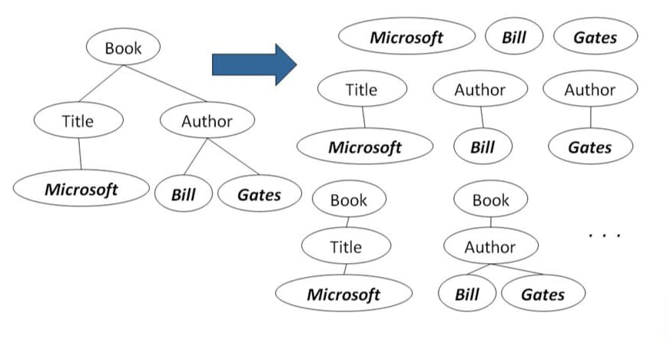
Showing a mapping of an XML document to set a lexicalized subtrees
Aim: To have each dimension of the vector space encode a word together with its position within the XML tree.
How: Map XML documents to lexicalized subtrees.

Slide 10
Text-centric VS Data-centric XML
Data-centric
Text-centric
Long text field
Inexact matching
Relevance-ranked results
Assembly manuals, issues of journals, Shakespeare’s collected works and newswire articles
No ranking
Exact matching
Commonly used for data collection with complex structure.
Mainly contain non-text data

Slide 11
Recommendation system
Recommender systems are a way of suggesting like or similar items and ideas to a users specific way of thinking.
Recommender systems are widely used on the Web for recommending products and services to users
Recommender systems try to automate aspects of a completely different information discovery model where people try to find other people with similar tastes and then ask them to suggest new things.
The goal of a recommender system is to generate meaningful recommendations to a collection of users for items or products that might interest them.
Recommendation systems are a key part of almost every modern consumer website.
Recommender systems predict the preference of the user for these items, which could be in the form of a rating or response.
There are a variety of applications for recommendations including movies (e.g. Netflix), consumer products (e.g., Amazon or similar on-line retailers), music (e.g. Spotify), or news, social media, online dating and advertising.

Slide 12
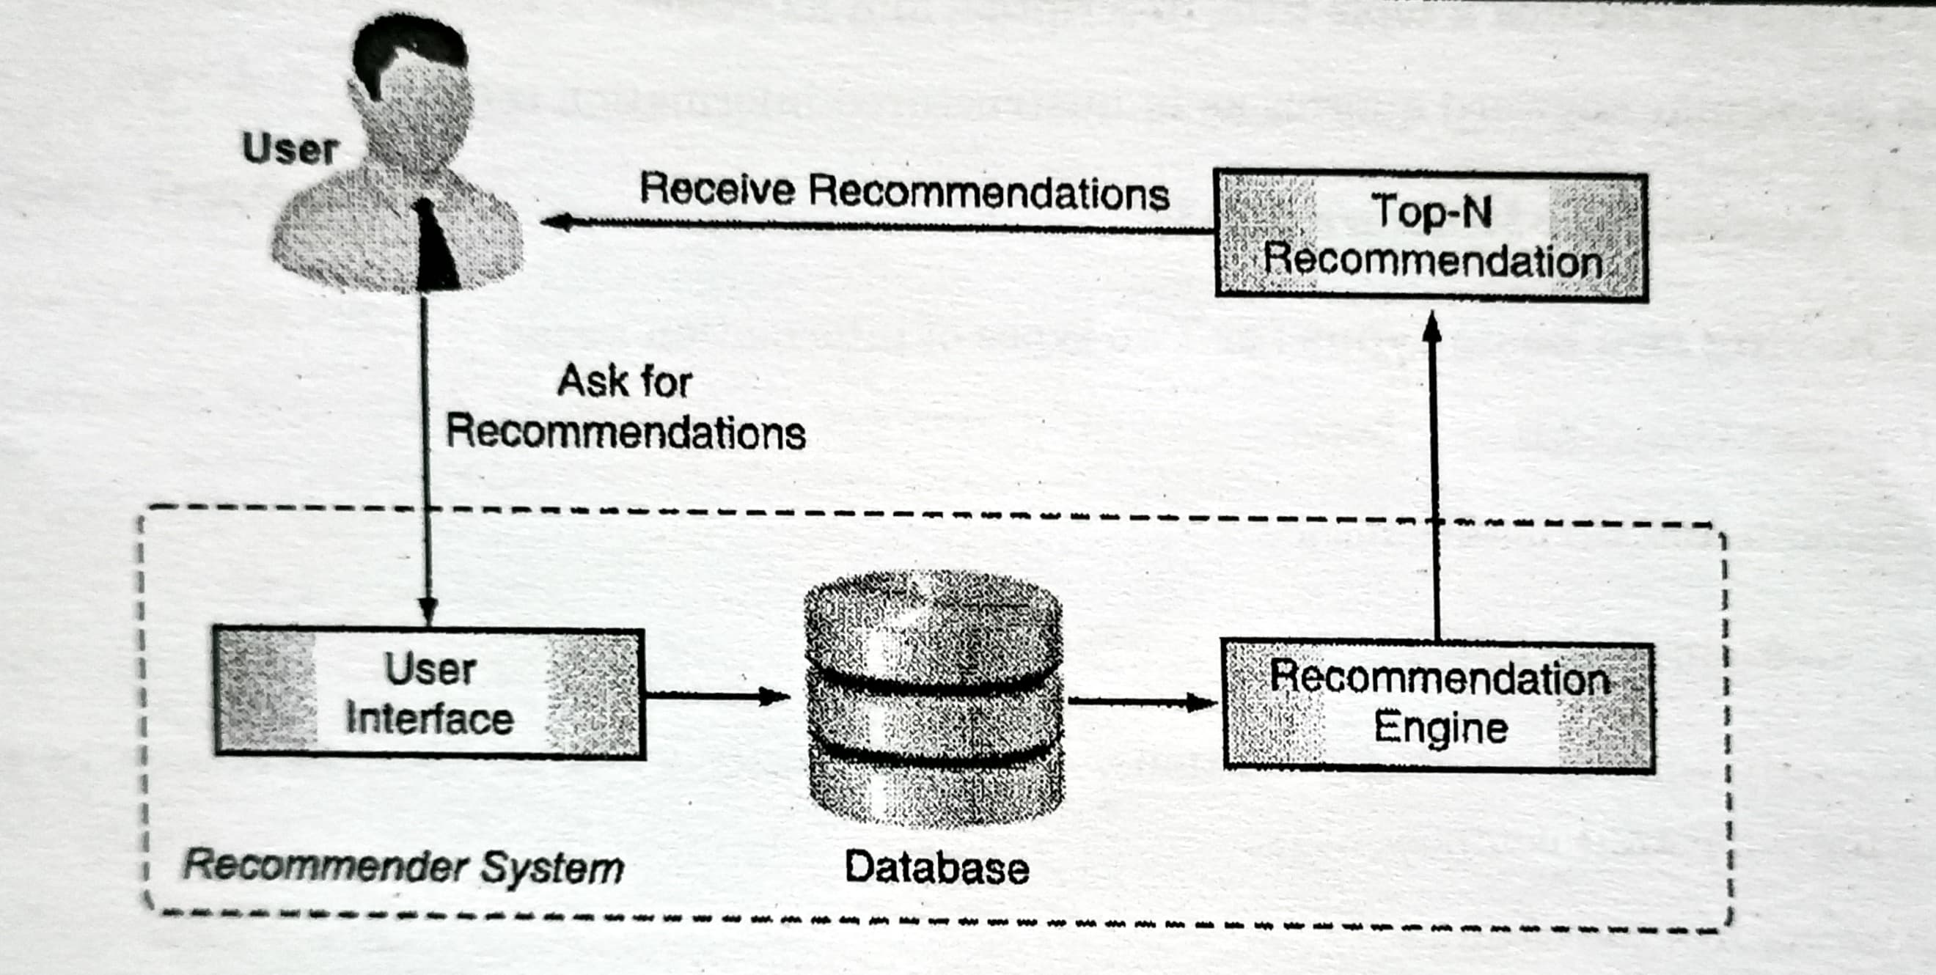
Working of recommender system
.

Slide 13
Types of recommendation techniques
In general, there are three types of recommender system:
1) Collaborative recommender system is a system that produces its result based on past ratings of users with similar preferences
2)Content based recommender system is a system that produces its result based on the similarity of the content of the documents or items.
3)Knowledge based recommender system is a system that produces its result based on additional and means-end knowledge.
4)Demographic based recommender system: This type of recommendation system categorizes users based on a set of demographic classes.
5)Hybrid recommender systems combine various inputs and different recommendation strategies to take advantage of the synergy among them.

Slide 14
Challenges in recommendation system
Huge amounts of data, tens of millions of customers and millions of distinct catalog items.
Results are required to be returned in real time.
New customers have limited information.
Old customers can have a glut of information.
Customer data is volatile.
Recommendation process
Collection Storing Analyzing Filtering

Slide 15
Collaboration Filtering
Collaborative filtering is a method of making automatic predictions (filtering) about the interests of a single user by collecting preferences or taste information.
Collaborative filtering (CF) uses given rating data by many users for many items as the basis for predicting missing ratings and/or for creating a top-N recommendation list for a given user, called the active user. Formally, we have a set of users U = (U1, U2, …and a set of items I = (i1, 12, in).
Ratings are stored in a m x n user-item rating matrix.
The problem of collaborative filtering is to predict how well a user will like an item that he has not rated given a set of historical preference judgments for a community of users.

Slide 16
Types of collaborative filtering
Type 1-User based:
User-based collaborative filtering algorithms work off the premise that if a user(A) has a similar profile to another user (B), then A is more likely to prefer things that B prefers when compared with a user chosen at random.
For example, a collaborative filtering recommendation system for television tastes could make predictions about which television show a user should like given a partial list of that user's tastes (likes or dislikes).
Type 2-Item-based collaborative filtering:
Item-based CF is a model-based approach which produces recommendations based on the relationship between items inferred from the rating matrix. The assumption behind this approach is that users will prefer items that are similar to other items they like.

Slide 17
Advantages and disadvantages of collaborative filtering
 | Advantages | Disadvantages
Collaboration approach | Other user’s scores are used No deterministic result since chance is involved in the system | Needs more data Problem with new user’s and new products
Content-based approach | works with lesser data Provides results based on activities of the specific user | Over-specialization

Slide 18
Content based recommendation of document
content based recommenders refer to such approaches, that provide - recommendations by comparing representations of content describing an item to representations of content that interests the user.
Content-based recommendation systems try to recommend items similar to those a given user has liked in the past.
Advantages
User Independence: Recommends only the items that interest the user .
Transparency : Recommendation is based on the item features, explicitly list the contents features.
New Item: Helps in recommending new items that are not yet rated by other.

Slide 19
Semantic web in details
The Semantic Web is not a separate Web but an extension of the current one, in which information is given well-defined meaning, better enabling computers and people to work in cooperation.
Semantic Web challenge: provide language that expresses both data and rules for reasoning about that data.
The Semantic Web will enable machines to COMPREHEND semantic documents and data, not human speech and writings, Semantic Web, in contrast, is more flexible.
Semantic Web languages today:
1. Resource Description Framework (RDF)
2. Web Ontology Language

Slide 20
Ontology language
The W3C Web Ontology Language (OWL) is a Semantic Web language designed to represent rich and complex knowledge about things, groups of things, and relations between things.
OWL is a computational logic-based language such that knowledge expressed in OWL can be exploited by computer programs, e.g., to verify the consistency of that knowledge or to make implicit knowledge explicit.

Slide 21
Thank you…

